Slide 1
UNIT III: DATA PERSISTENCE

Slide 2
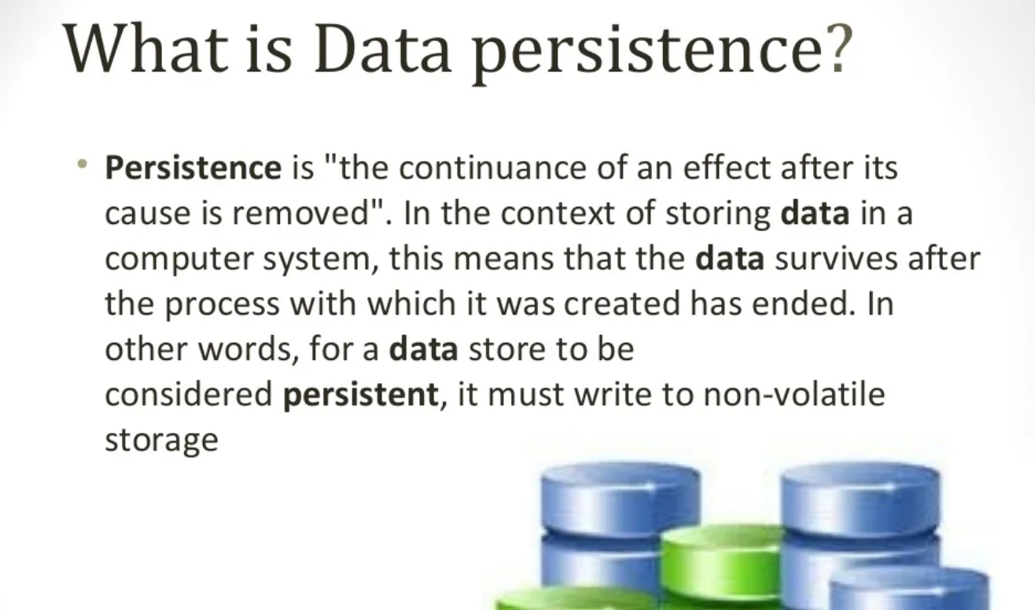
UNIT III: DATA PERSISTENCE

Slide 3
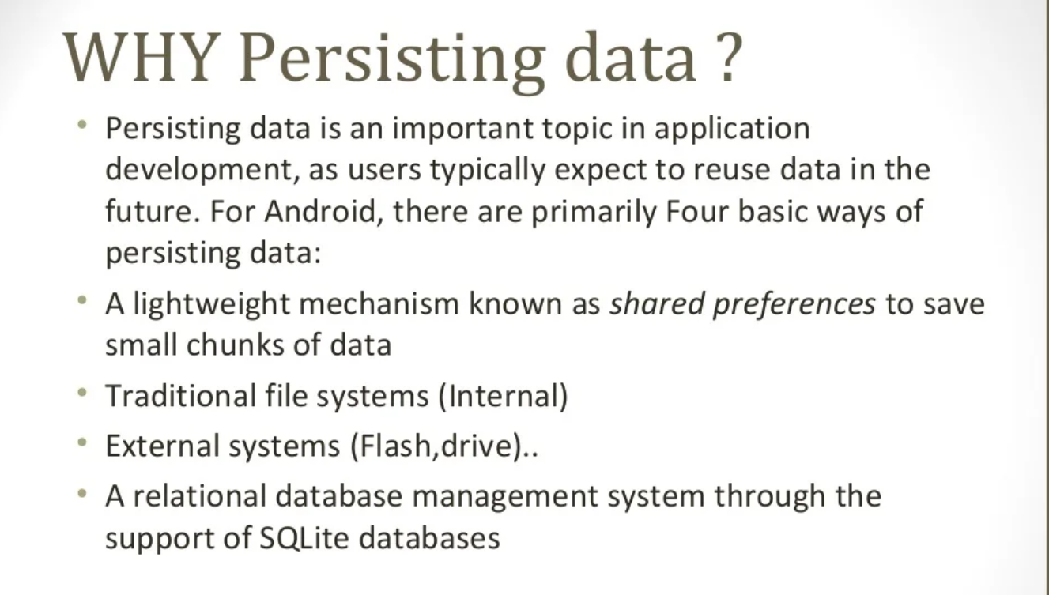

Slide 4
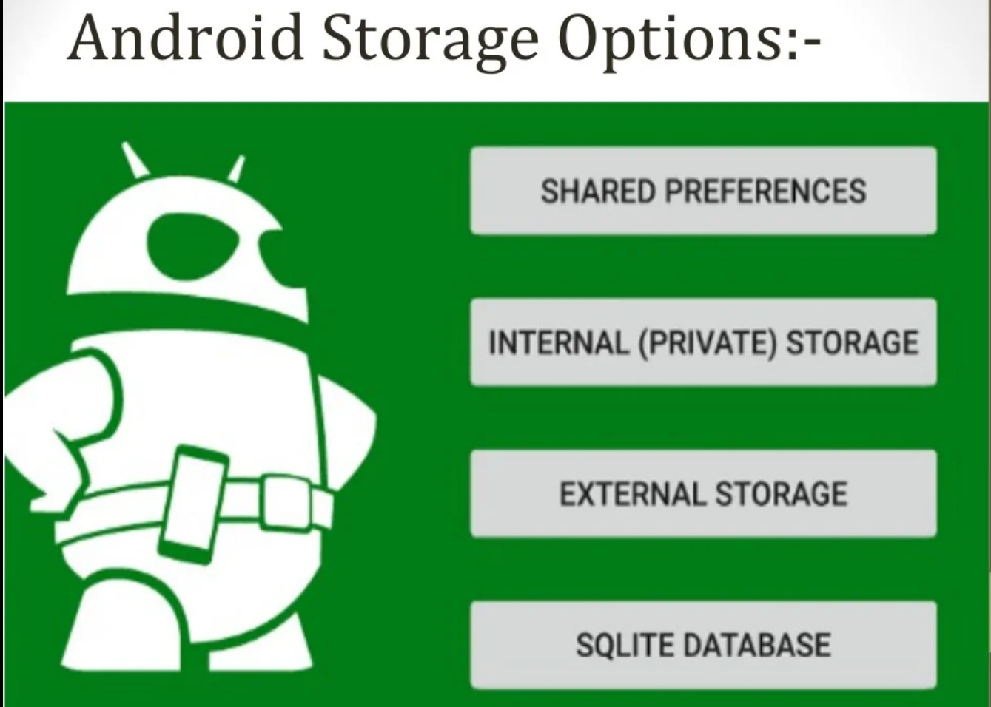

Slide 5
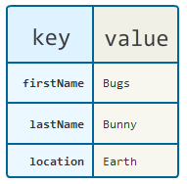
SharedPreferences
Android provides many ways of storing data of an application. One of this way is called Shared Preferences API.
Eg:- Username, Password, Firstname, Lastname, email id, mobile no, DOB, etc..(profile details)
Shared Preferences allow you to save and retrieve data based on key-value pair. (booleans, floats, ints, longs, and strings).
Datatype variable = value

Slide 6
SharedPreferences
Shared – distribute data
Preference – important or preferable
Preference File
Preference file is XML file saved in internal memory in device.
You can create a new shared preference file or access an existing one by calling one of these methods:
Activity preference
Custom preference

Slide 7
SharedPreferences
Activity preference : getPreferences (int mode)
developer have to call function getPreferences(int mode)
Use this if you need to use only one shared preference file for the activity.
Because this retrieves a default shared preference file that belongs to the activity.
Custom Preferences : getSharedPreferences(String name,int mode)
Developer needs to use getSharedPreferences (String name, int mode) for custom preferences.

Slide 8
SharedPreferences
Save Data In SharedPreferences:
Call the method edit() to get a SharedPreferences. Editor;
To add SharedPreferences values use the methods as putBoolean(), putString(), putint(String Keyname int value);
To save the values you must call commit().
Read or get data from SharedPreferences
To read SharedPreferences values use the methods as getBoolean() and getString().

Slide 9
Eg:- To get saved int value just call getInt(“GameScore”,-1) function where “GameScore” is key and -1 is a default value in case no value was saved for GameScore.
To remove data call remove(String key)
To clear all data just call function clear().

Slide 10
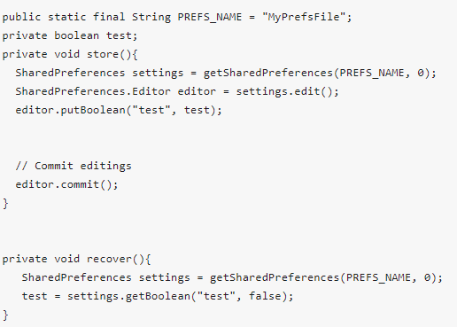
SharedPreferences
Below is an example of storing and removing data from a preference:

Slide 11
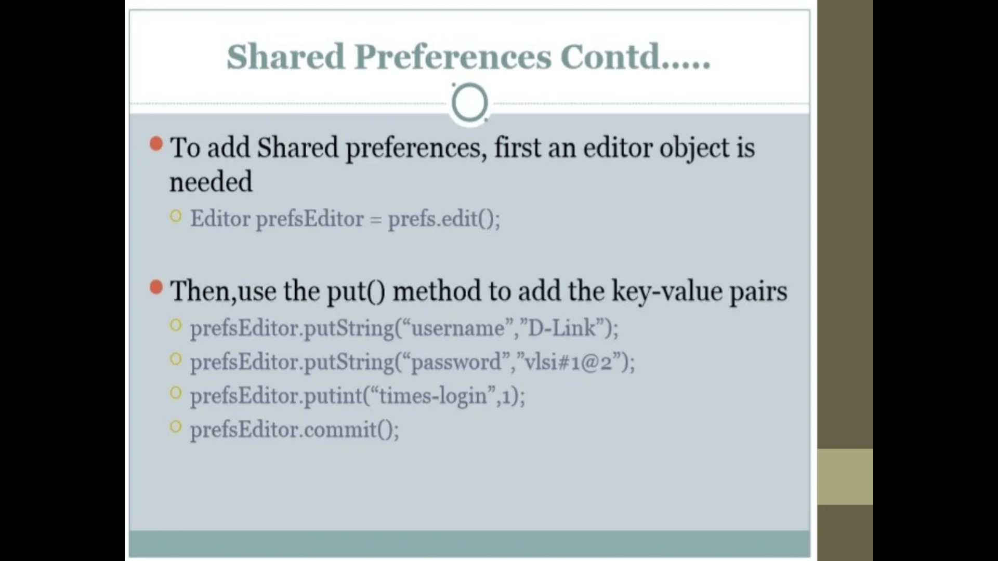
SharedPreferences

Slide 12
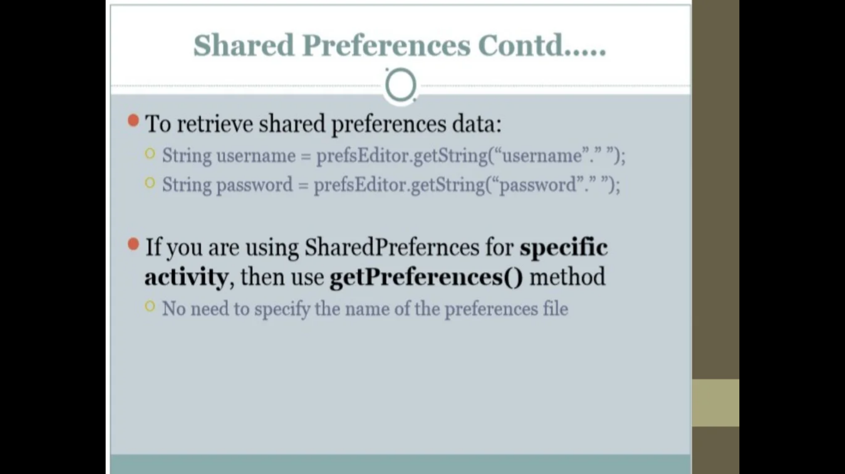
SharedPreferences

Slide 13
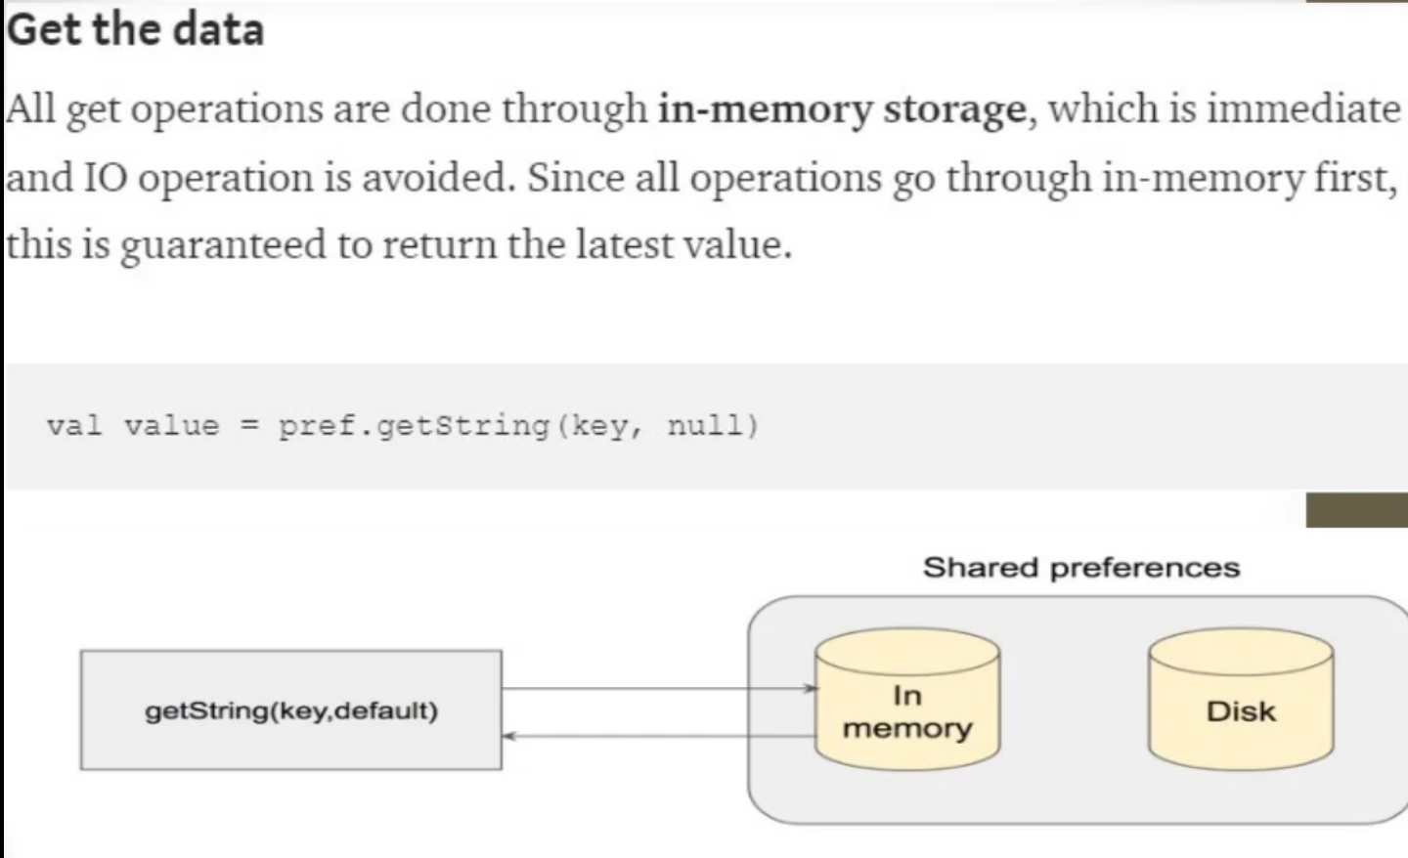
SharedPreferences

Slide 14
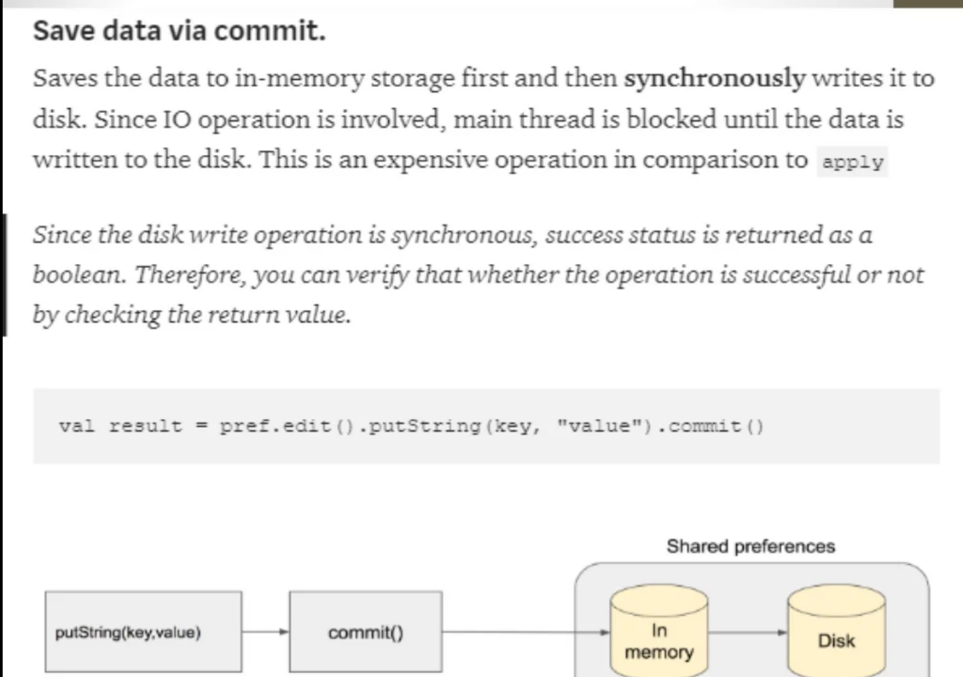
SharedPreferences

Slide 15
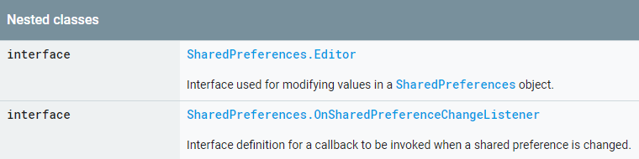
SharedPreferences

Slide 16
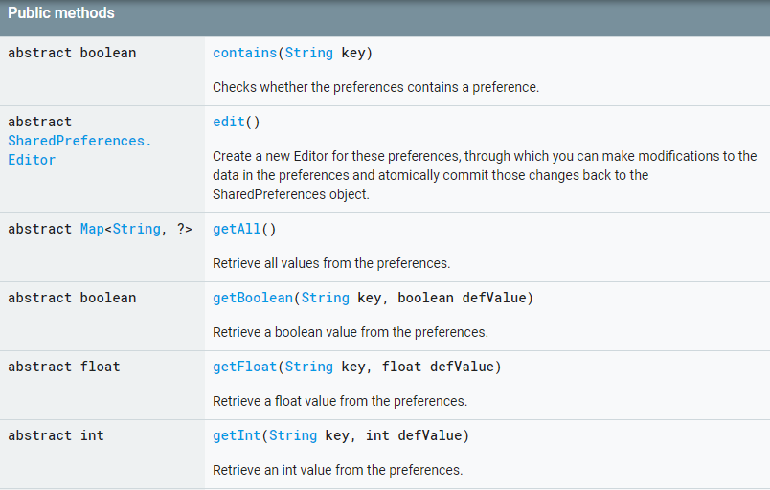
SharedPreferences

Slide 17
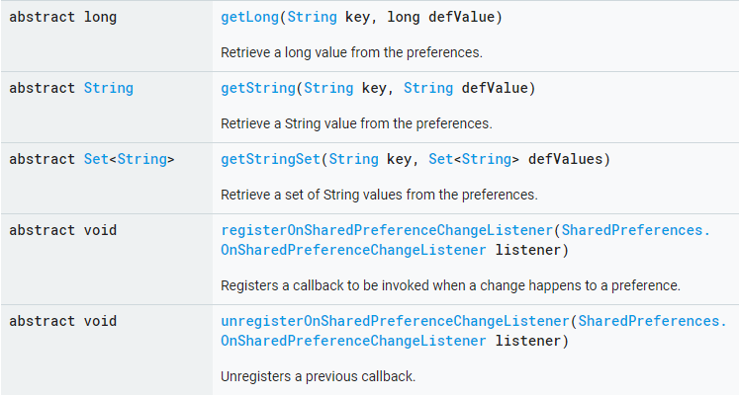
SharedPreferences

Slide 18
File Handling
A File object works well for reading or writing large amounts of data.
The exact location of the where your files can be saved might vary across devices.
To view files on a device, you can log the file location provided by methods such as File.getAbsolutePath(), and then browse the device files with Android Studio's DeviceFileExplorer.
All Android devices have two file storage areas: "internal" and "external" storage.
Most Android devices offered built-in non-volatile memory (internal storage), plus a removable storage medium such as a micro SD card (external storage).

Slide 19
File Handling
Internal storage
External storage
It's always available.
Files saved here are accessible by only your app.
When the user uninstalls your app, the system removes all your app's files from internal storage.
It's not always available, because the user can mount the external storage as USB storage and in some cases remove it from the device.
It's world-readable, so files saved here may be read outside of your control.
When the user uninstalls your app, the system removes your app's files from here only if you save them in the directory from getExternalFilesDir().

Slide 20
File Handling
Write a file
When saving a file to internal storage, you can acquire the appropriate directory as a File by calling one of two methods:
getFilesDir()
Returns a File representing an internal directory for your app.
getCacheDir()
Returns a File representing an internal directory for your app's temporary cache files.
File file = new File(context.getFilesDir(), filename);

Slide 21
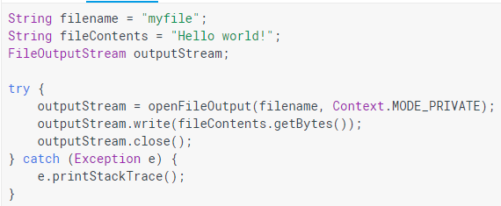
File Handling

Slide 22
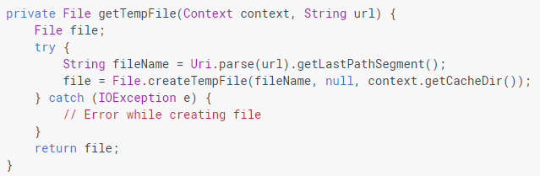
File Handling
Write a cache file
If you instead need to cache some files, you should use createTempFile(). For example, the following method extracts the file name from a URL and creates a file with that name in your app's internal cache directory:

Slide 23
File Handling
Open an existing file
To read an existing file, call openFileInput(name), passing the name of the file.
You can get an array of all your app's file names by calling fileList().
Open a directory
You can open a directory on the internal file system with the following methods:
getFilesDir()
Returns a File representing the directory on the file system that's uniquely associated with your app.

Slide 24
File Handling
getDir(name, mode)
Creates a new directory (or opens an existing directory) within your app's unique file system directory. This new directory appears inside the directory provided by getFilesDir().
getCacheDir()
Returns a File representing the cache directory on the file system that's uniquely associated with your app. This directory is meant for temporary files, and it should be cleaned up regularly. The system may delete files there if it runs low on disk space, so make sure you check for the existence of your cache files before reading them.

Slide 25
File Handling
File directory = context.getFilesDir();
File file = new File(directory, filename);
Delete a file
You should always delete files that your app no longer need. The most straightforward way to delete a file is to call delete() on the File object.
myFile.delete();
File read & write
https://www.tutorialspoint.com/android/android_internal_storage.htm
https://www.javatpoint.com/android-internal-storage-example

Slide 26
SQLite database
SQLite is a opensource SQL database that stores data to a text file on a device.
Android comes in with built in SQLite database implementation.
SQLite supports all the relational database features.
In order to access this database, you don't need to establish any kind of connections for it like JDBC,ODBC e.t.c
SQLiteOpenHelper class provides the functionality to use the SQLite database.

Slide 27
Managing data using SQLite database
Managing data using SQLite database
android.database.sqlite package contains the classes to manage your own databases.
Create a database using an SQL helper
In order to create a database you just need to call this method openOrCreateDatabase with your database name and mode as a parameter.
SQLiteDatabase mydatabase = openOrCreateDatabase(“ SRM_DB", MODE_PRIVATE,null);

Slide 28
Managing data using SQLite database
mydatabase.execSQL("CREATE TABLE IF NOT EXISTS SRM(Username VARCHAR,Password VARCHAR);");
mydatabase.execSQL("INSERT INTO SRM VALUES('admin','admin');");
To access your database, instantiate your subclass of SQLiteOpenHelper
FeedReaderDbHelper mDbHelper = newFeedReaderDbHelper(getContext());

Slide 29
Managing data using SQLite database
Put information into a database
Insert data into the database by passing a ContentValues object to the insert() method:
SQLiteDatabase db=mDbHelper.getWritableDatabase();
public boolean insertContact (String name, String phone, String email, String street,String place)
{
SQLiteDatabase db = this.getWritableDatabase();
ContentValues contentValues = new ContentValues();
contentValues.put("name", name); contentValues.put("phone", phone);
contentValues.put("email", email); contentValues.put("street", street);
contentValues.put("place", place);
db.insert("contacts", null, contentValues);
return true; }

Slide 30
Managing data using SQLite database
Read information from a database
To read from a database, use the query() method, passing it your selection criteria and desired columns. The method combines elements of insert() and update()
SQLiteDatabase db=mDbHelper.getReadableDatabase();
public Cursor getData(int id)
{
SQLiteDatabase db = this.getReadableDatabase();
Cursor res = db.rawQuery( "select * from contacts where id="+id+"", null );
return res;
}

Slide 31
Managing data using SQLite database
Android SQLite Cursor
A Cursor represents the entire result set of the query.
Once the query is fetched a call to cursor. moveToFirst() is made.
The basic purpose of a cursor is to point to a single row of the result fetched by the query.
We load the row pointed by the cursor object.

Slide 32
Managing data using SQLite database
Delete information from a database
To delete rows from a table, you need to provide selection criteria that identify the rows to the delete() method.
public Integer deleteContact (Integer id)
{
SQLiteDatabase db = this.getWritableDatabase();
return db.delete("contacts", "id = ? ", new String[] { Integer.toString(id) });
}

Slide 33
Managing data using SQLite database
Update a database
When you need to modify a subset of your database values, use the update() method.
public boolean updateContact (Integer id, String name, String phone, String email, String street,String place)
{
SQLiteDatabase db = this.getWritableDatabase();
ContentValues contentValues = new ContentValues();
contentValues.put("name", name); contentValues.put("phone", phone);
contentValues.put("email", email); contentValues.put("street", street);
contentValues.put("place", place);
db.update("contacts", contentValues, "id = ? ", new String[] { Integer.toString(id) } );
return true; }
Complete program example:
https://www.tutorialspoint.com/android/android_sqlite_database.htm

Slide 34
Managing data using SQLite database
Saving data to a database is ideal for repeating or structured data, such as contact information.
The APIs you'll need to use a database on Android are available in the android.database.sqlite package.

Slide 35
Managing data using SQLite database
Create a database using an SQL helper
Once you have defined how your database looks, you should implement methods that create and maintain the database and tables.
Just like files that you save on the device's internal storage, Android stores your database in your app's private folder.
Your data is secure, because by default this area is not accessible to other apps or the user.
The SQLiteOpenHelper class contains a useful set of APIs for managing your database.

Slide 36
Managing data using SQLite database
Put information into a database
Insert data into the database by passing a ContentValues object to the insert() method:
The first argument for insert() is simply the table name.
The second argument tells the framework what to do in the event that the ContentValues is empty
https://www.digitalocean.com/community/tutorials/android-sqlite-database-example-tutorial

Slide 37
Content providers
It is a central repository in which data of the applications are stored.
It facilitates other applications to securely access and modifies that data based on the user requirements.
A content provider behaves like a database where you can query it, edit its content, as well as add or delete content.
In most cases this data is stored in an SQlite database.

Slide 38
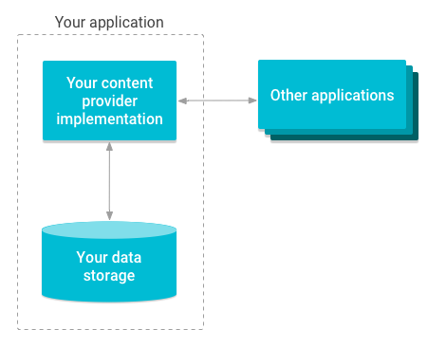
Content providers
Content providers are the standard interface that connects data in one process with code running in another process.
Content providers can help an application manage access to data stored by itself or stored by other apps and provide a way to share data with other apps.

Slide 39
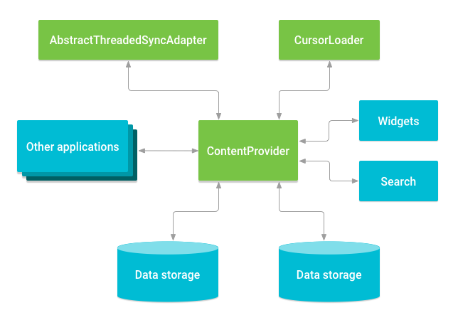
Content providers
Relationship between content provider and other components.

Slide 40
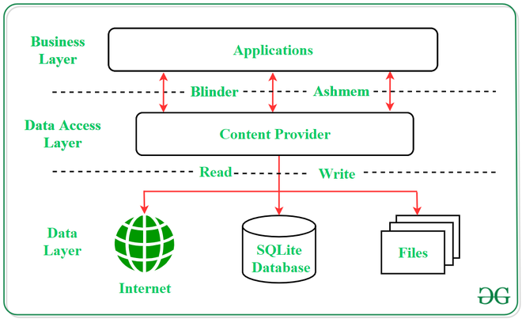
Content providers

Slide 41
Content providers
A content provider manages access to a central repository of data.
A provider is part of an Android application, which often provides its own UI for working with the data.
A content provider presents data to external applications as one or more tables that are similar to the tables found in a relational database.
A content provider coordinates access to the data storage layer in your application for a number of different APIs.

Slide 42
Content providers
Sharing access to your application data with other applications
Sending data to a widget
Returning custom search suggestions for your application through the search framework using SearchRecentSuggestionsProvider.
Synchronizing application data with your server using an implementation of AbstractThreadedSyncAdapter
Loading data in your UI using a CursorLoader

Slide 43
Content providers
Accessing a provider
When you want to access data in a content provider, you use the ContentResolver object in your application's Context to communicate with the provider as a client.
The ContentResolver methods provide the basic "CRUD" (create, retrieve, update, and delete) functions of persistent storage.
A common pattern for accessing a ContentProvider from your UI uses a CursorLoader to run an asynchronous query in the background.

Slide 44
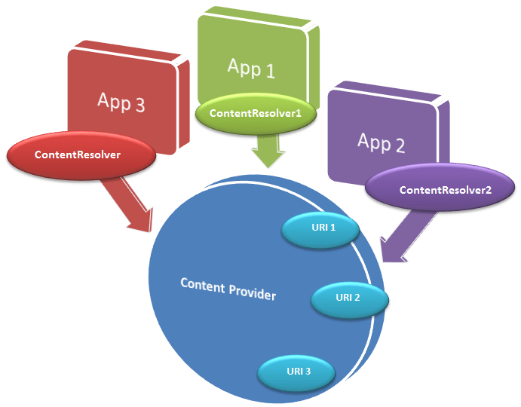
Content providers
Accessing a provider
When you want to access data in a content provider, you use the ContentResolver object in your application's Context to communicate with the provider as a client.
The ContentResolver methods provide the basic "CRUD" (create, retrieve, update, and delete) functions of persistent storage.
A common pattern for accessing a ContentProvider from your UI uses a CursorLoader to run an asynchronous query in the background.

Slide 45
Content providers
Content URI
Content URI(Uniform Resource Identifier) is the key concept of Content providers. To access the data from a content provider, URI is used as a query string.
Structure of a Content URI: content://authority/optionalPath/optionalID
Operations in Content Provider
Create: Operation to create data in a content provider.
Read: Used to fetch data from a content provider.
Update: To modify existing data.
Delete: To remove existing data from the storage.

Slide 46
Content providers
Working of the Content Provider
UI components of android applications like Activity and Fragments use an object CursorLoader to send query requests to ContentResolver.
The ContentResolver object sends requests (like create, read, update, and delete) to the ContentProvider as a client.
After receiving a request, ContentProvider process it and returns the desired result.

Slide 47
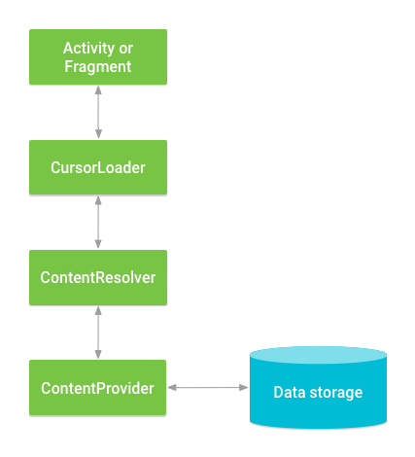
Content providers

Slide 48
Content providers
Content Provider creation
First of all you need to create a Content Provider class that extends the ContentProviderbaseclass.
Second, you need to define your content provider URI address which will be used to access the content.
Next you will need to create your own database to keep the content. Usually, Android uses SQLite database and framework needs to override onCreate() method which will use SQLite Open Helper method to create or open the provider's database. When your application is launched, the onCreate() handler of each of its Content Providers is called on the main application thread.
Next you will have to implement Content Provider queries to perform different database specific operations.
Finally register your Content Provider in your activity file using <provider> tag.

Slide 49
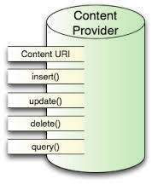
Content providers
ContentProvider methods
onCreate() This method is called when the provider is started.
query() This method receives a request from a client. The result is returned as a Cursor object.
insert()This method inserts a new record into the content provider.
delete() This method deletes an existing record from the content provider.
update() This method updates an existing record from the content provider.
getType() This method returns the MIME type of the data at the given URI.
Complete example:
https://www.tutorialspoint.com/android/android_content_providers.htm#

Slide 50
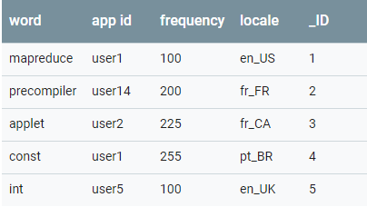
Android in build content providers
One of the built-in providers in the Android platform is the user dictionary, which stores the spellings of non-standard words that the user wants to keep.

Slide 51
Android in build content providers
In table 1, each row represents an instance of a word that might not be found in a standard dictionary. Each column represents some data for that word, such as the locale in which it was first encountered.
The column headers are column names that are stored in the provider. To refer to a row's locale, you refer to its locale column. For this provider, the _ID column serves as a "primary key" column that the provider automatically maintains.
To get a list of the words and their locales from the User Dictionary Provider, you call ContentResolver.query(). The query() method calls the ContentProvider.query() method defined by the User Dictionary Provider. The following lines of code show a ContentResolver.query() call:

Slide 52
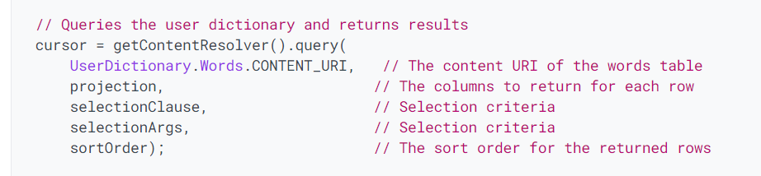
Android in build content providers
https://developer.android.com/guide/topics/providers/content-provider-basics#:~:text=A%20content%20provider%20manages%20access,using%20a%20provider%20client%20object.

